Slide 1
Model Serving
Enablement
ML Inference Team Sep 2023
Notes:
Please contact ahmed.bilal for feedback on these slides

Slide 2
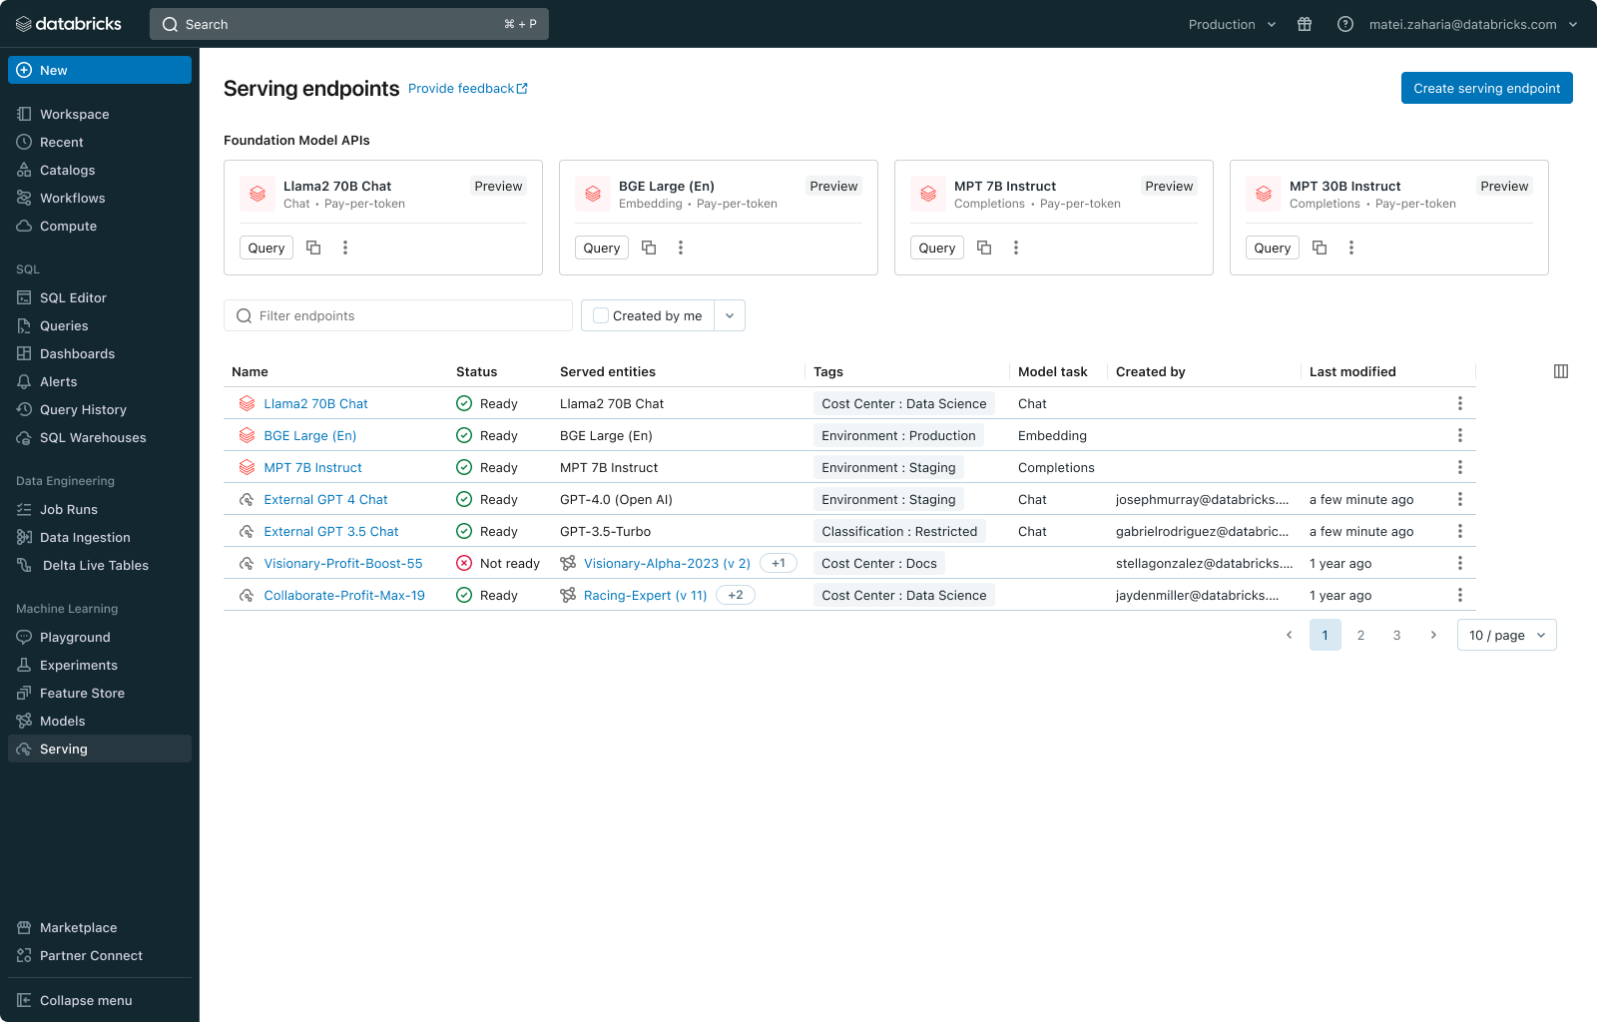
Databricks Model Serving
Access, Govern, and Monitor any AI Models with Databricks Model Serving
Build AI apps faster with Unified Model Serving: Deploy or query any model though a unified interface, including Custom Models, Databricks-managed Foundations Models (like base/fine-tuned Llama2), or externally-hosted models (like OpenAI GPT 3.5)
Reduce TCO with Serverless Serving: Highly available and scalable serving with LLM-specific optimization that reduces latency and cost
Scale deployments with Data Intelligence Platform: Automatic feature/vector lookups, monitoring, and unified governance that scales deployments and reduces errors

Slide 3
Putting a model in production is hard
Experimenting Across Models: Each use case requires experimentation to identify the best model among open and proprietary options.
Building Quality Systems: State-of-the-art AI result comes from combining models, not just single models.
Operationalizing AI: Different interfaces among models make it challenging to centrally govern, safeguard, and monitor them.
strictly confidential - internal use only
Notes:
As we spoke with customers, it became very clear that these are not isolated solutions. Customers told us very clearly, 'Bilal, we need to experiment and compare models. How can we do that? We have use cases that often require multiple models; is there an easy way to accomplish this? We want monitoring and guardrails across all options. When is that coming?

Slide 4

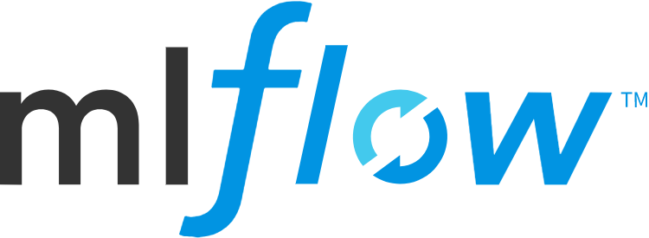

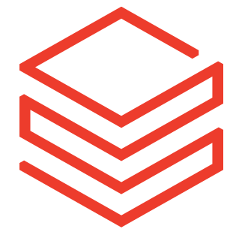

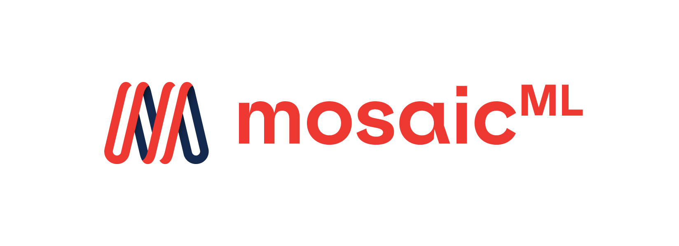






Databricks Model Serving
Unified UI, API & SDK for managing all types of AI Models
Model Serving
Custom Models
Foundation Models APIs
External Models
Access any AI Model, be it a fully custom model, a Databricks-managed model, or a 3rd-party Foundation Model.
Govern and Monitor all Models in one place
Query Models via unified interface (Single API, SDK and UI)
Notes:
Logos show are:
Custom Models
MLflow
Hugging Face
Databricks
LangChain
Foundation Models
Meta (such as Llama 2)
MosaicML (such as MPT)
Databricks
External Models
OpenAI
Anthropic
AWS Bedrock
AI21 Labs
Cohere

Slide 5
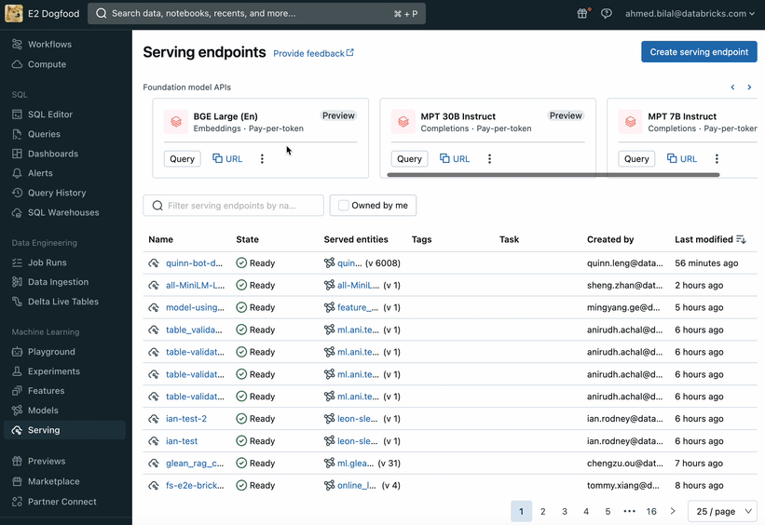
Foundation Model APIs
Fully Featured, Enterprise Grade and Secure API endpoints
Instantly access popular Foundation Models securely within Databricks
Flexible Pricing: Start with pay-per-token pricing or deploy fine-tuned models with performance guarantees on Provisioned Throughput
Reduce TCO with latency and throughput optimization
Roadmap: GA (Q1)
Additional Models (Q1)
Smaller units for PT (Q1)
Functions Calling (Q2)
Notes:
go/serving/low-latency

Slide 6
Foundation Models APIs
Fully Featured, Enterprise Grade and Secure API endpoints
Pay-per-token:
Fastest way to experiment Foundation Models on Databricks
Access popular OSS foundational models
On-demand per token pricing
Provisioned Throughput:
Move to production with guaranteed performance
Deploy base models or models fine tuned on your proprietary data
Consistent latency with guaranteed throughput
Dedicated compute with isolated network
Availability SLA, Shield Compliance*, Regional co-location
On-demand per throughput pricing

Slide 7
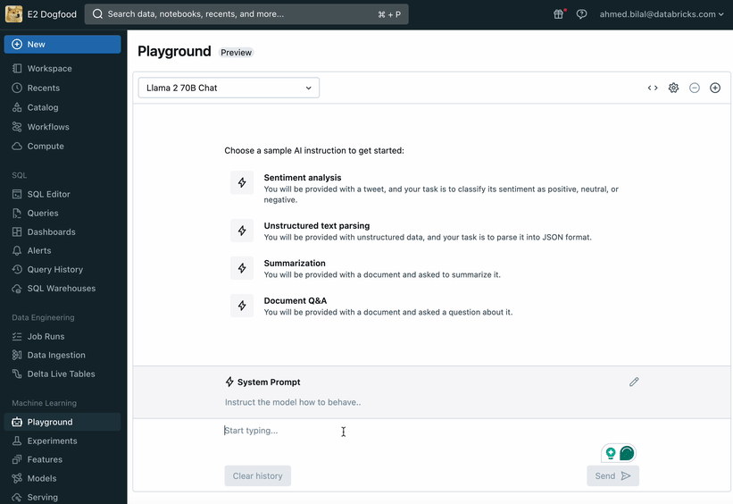
AI Playground
Easily interact and compare LLMs
Easily interact with foundations models hosted both internally and externally to Databricks.
Compare output, latency and other performance characteristics across multiple models
Rapidly experiment with prompt engineering and text generation parameter tuning
Notes:
go/serving/low-latency

Slide 8
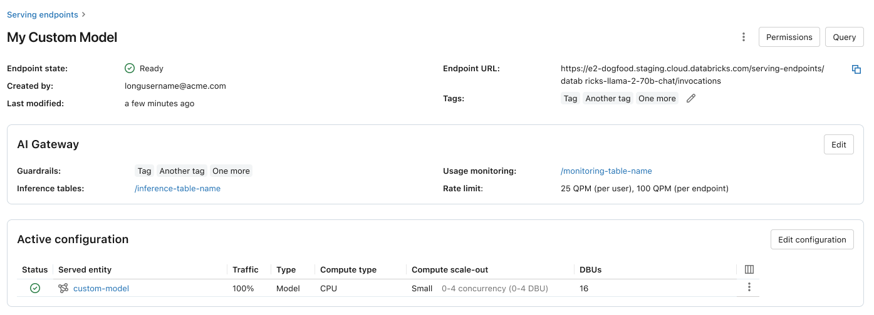
AI Gateway for model API governance
Centralized governance to democratize GenAI
Permission and rate limiting to control who has access and how much access
Payload logging and usage tracking to audit data being sent to model APIs and who is calling them
AI Guardrails to prevent data leakage and unsafe requests/responses.

Slide 9
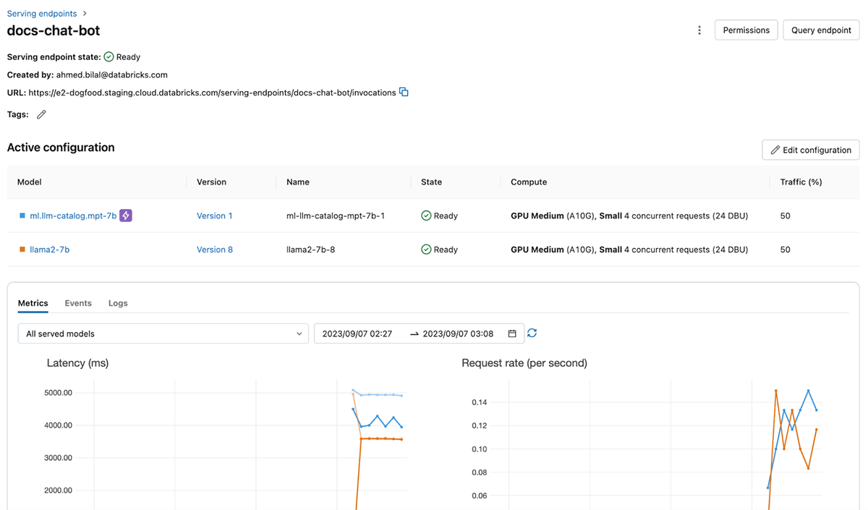
Improve model quality with your proprietary data
Foundation models have broad knowledge but lack internal knowledge and domain expertise.
RAG and Fine Tuning integrate natively into Model Serving, making it easy to leverage data in Databricks
Roadmap: Fine-tuning API (Q1)
RAG Studio (Q1)
Notes:
Previously, I said that foundation models can be easily used for a wide use cases. Well, I wasn't entirely honest about that. That’s the stance many of our competitors are taking. The reality is that foundation models,when used as it, lack internal knowledge and domain expertise, making them unusable for most enterprise use cases.
So, what do we do? We enrich these models with private enterprise data. And there's no better place to do this than on Databricks. You can use the new FT API to easily fine-tune foundation models with proprietary data and then deploy them on Model Serving. And you can augment both unstructured data (via Vector Store) and structured data (by calling DBSQL) right into the model.

Slide 10
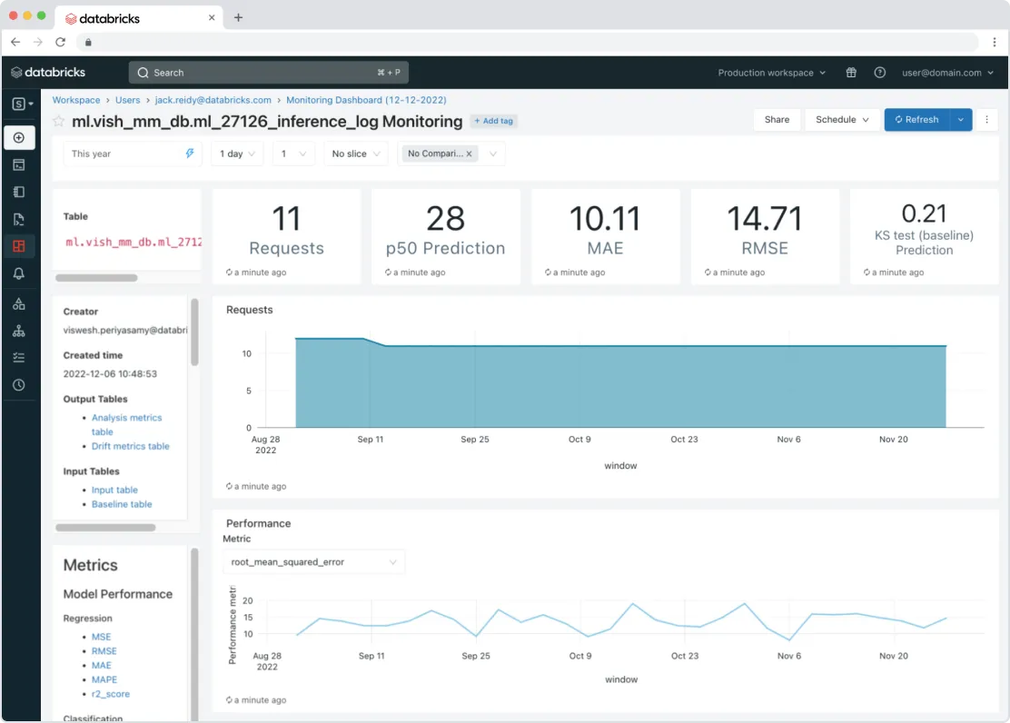
Operationalize models with unified governance and monitoring
Models must be monitored for quality, debugging, and safety purposes.
Databricks Model Serving manages permissions, tracks usage limits, and ensures the quality of all model types.
Roadmap: Pay-per-token &
External Models Support (Q1)
Usage Tracking (Q1)
One-click-monitoring (H1)

Slide 11
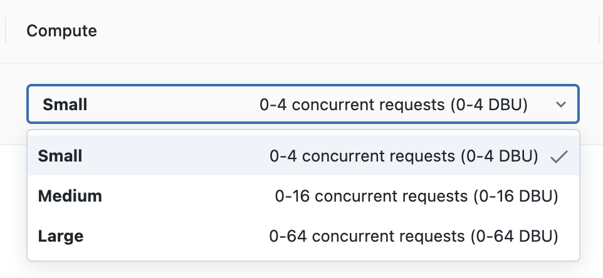
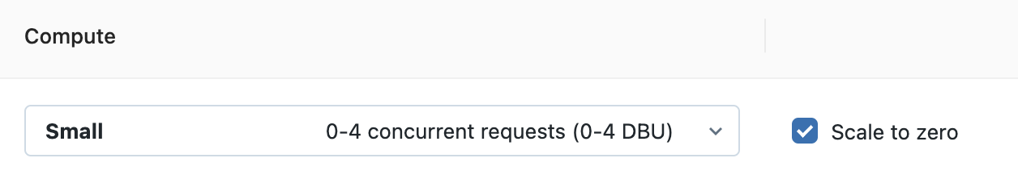
Reduce Latency and Cost with Serverless Serving
Serve LLMs with best-in-class latency and throughput with zero configuration.
Compute automatically scales up and down to meet traffic patterns
5x
5x
less-latency
more-throughput
Baseline
Optimized
Serving
Baseline
Optimized
Serving
Token Latency
Tokens per second
Roadmap: Improved latency (Q1), Faster autoscaling(Q1), Scale to zero (Q1)

Slide 12
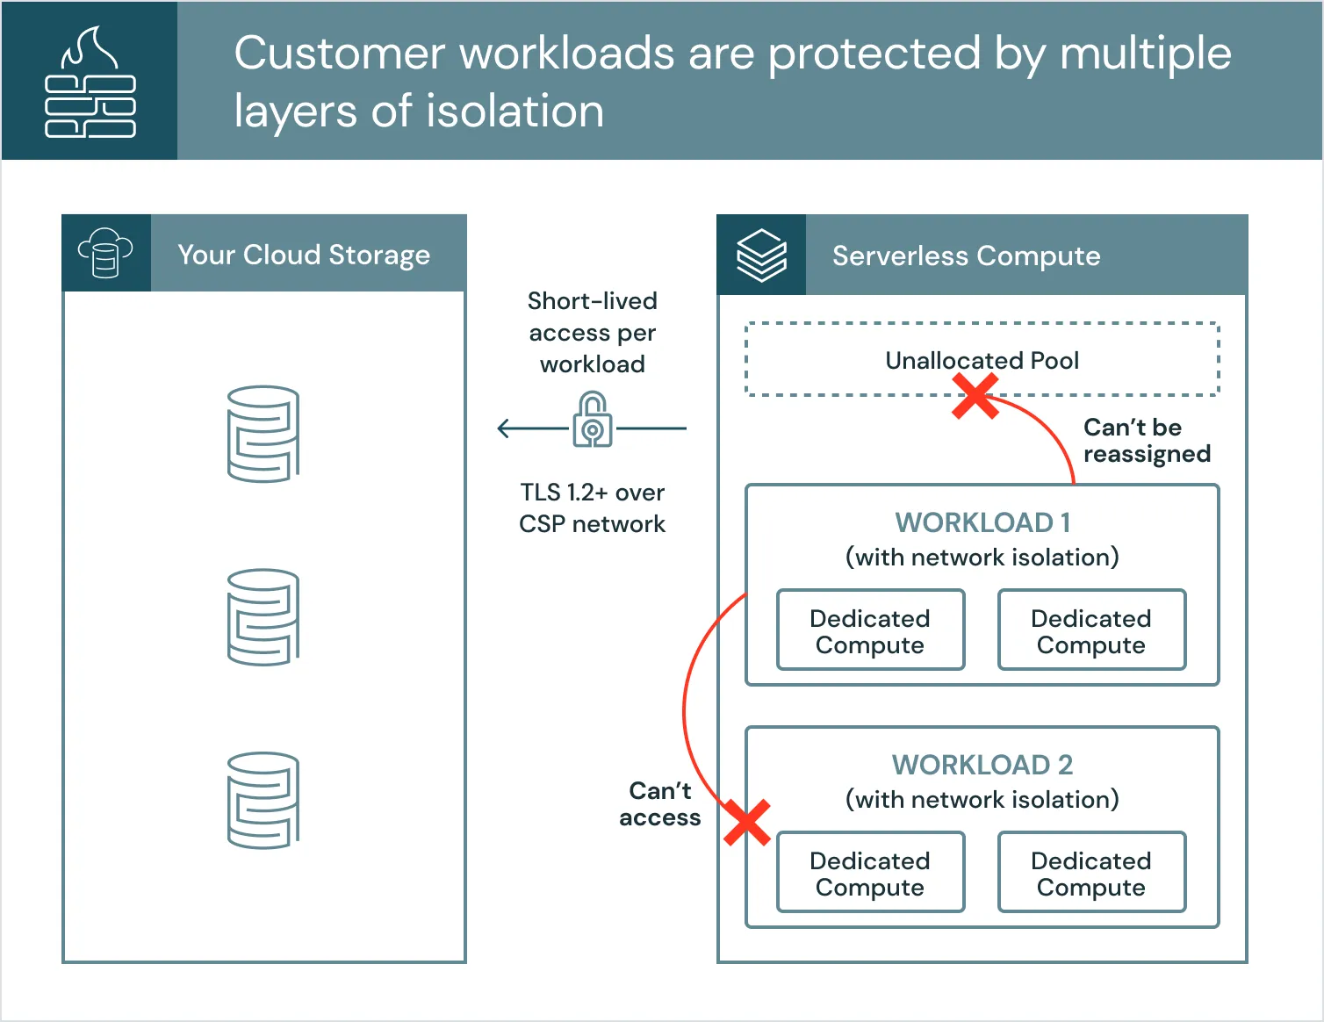
Highly Available and Secure Serving
Low Overhead Latency: Serve models with low overhead latency (P50 of 10ms and P99 of 20ms) and at QPS greater than 100K+
SLA-backed Availability Highly available with SLA guarantees of 99.95, supported by dedicated on-call engineering teams
Secure Deployment: Serve models on dedicated compute in an isolated network with multiple layers of security controls and strict compliance.
Roadmap: HIPAA Compliance (Q1)
100k+ QPS Support (H1)
Notes:
go/serving/low-latency

Slide 13



Build AI Apps with Databricks Model Serving
Low TCO
Accelerated deployments
Fewer Mistakes
⭐️Automatically capture requests and responses to monitor and debug models
Feature & Vector
Store
Monitoring
⭐️MLflow integration to seamlessly evaluate & deploy AI models
Retraining or Fine-Tuning
Evaluation & Deployment
Model Serving
⭐️Automated vector and feature lookups simplifies integration and reduces mistakes
Unity Catalog
Govern all data and ML assets
Cloud Data Lake
All structured and unstructured data

Slide 14



Customers trust Databricks Model Serving
"By doing model serving on the same platform where our data lives and where we train models, we have been able to accelerate deployments and reduce maintenance, ultimately helping us deliver for our customers and drive more enjoyable and sustainable living around the world." - Daniel Edsgärd, Head of Data Science at Electrolux
"Databricks Model Serving is accelerating our capability to infuse intelligence into a diverse array of use cases, ranging from meaningful semantic search applications to predicting media trends. By abstracting and simplifying the intricate workings of CUDA and GPU server scaling, Databricks allows us to focus on our real areas of expertise, namely expanding Condé Nast’s use of AI across all our applications without the hassle and burden of infrastructure" — Ben Hall, Sr. ML Engr at Condé Nast
"With Databricks Model Serving, we can now train, deploy, monitor, and retrain machine learning models, all on the same platform. By bringing model serving (and monitoring) together with the feature store, we can ensure models are always up-to-date and delivering accurate results. This streamlined approach allows us to focus on maximizing the business impact of AI without worrying about operational concerns." - Don Scott, VP Product Development at Hitachi Solutions

Slide 15

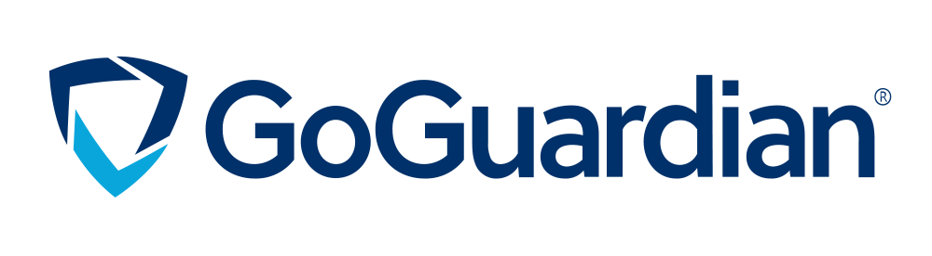

Customers trust Databricks Model Serving
"By doing model serving on a unified data and AI platform, we have been able to simplify the ML lifecycle and reduce maintenance overhead. This is enabling us to redirect our efforts towards expanding the use of AI across more of our business." - Vincent Koc, Head of Data at hipages group
Databricks Model Serving lets GoGuardian expose machine learning models as scalable REST API endpoints and provides a service for easy deployment.“We have helped numerous districts detect and assist students in need of mental health services through the ML models which power Beacon. It’s impossible to put a monetary value on that.”— Manoj Rawat, Director of Data Engineering, GoGuardian
“The fast auto-scaling keeps costs low while still allowing us to scale as traffic demand increases. Our team is now spending more time building models solving customer problems rather than debugging infrastructure-related issues.” — Gyuhyeon Sim, CEO at Letsur.ai

Slide 16



Customers trust Databricks Model Serving
“Databricks Model Serving is accelerating our AI-driven projects by making it easy to securely access and manage multiple SaaS and open models, including those hosted on or outside Databricks. Its centralized approach simplifies security and cost management, allowing our data teams to focus more on innovation and less on administrative overhead.” — Greg Rokita, AVP, Technology at Edmunds.com
“Databricks Foundation Model APIs allow us to query state-of-the-art open models with the push of a button, letting us focus on our customers rather than on wrangling compute. We’ve been using multiple models on the platform and have been impressed with the stability and reliability we’ve seen so far, as well as the support we’ve received any time we’ve had an issue.” — Sidd Seethepalli, CTO & Founder, Vellum
"Databricks provides us with a unified environment to train, deploy, and monitor various machine learning models. Using Inference Tables and Model Serving, we are able to monitor and debug deployed models which help us to maintain the model performance over time. This is enabling us to deliver improved models for a better customer experience on Housing.com" — Dr. Anil Goyal, Principal Data Scientist at Housing.com

Slide 17
Deep Dives
[Share Externally With Approval]

Slide 18
GA: Supported Regions
See regional roadmap at go/serving/regions. If your customer needs a different region please see go/serving/region-es

Slide 19
Serving Latency
Breaking down end-to-end latency
Scoring request end-to-end latency is affected by a few factors
Distance from client application to Databricks
Databricks overhead for authentication and request forwarding
We defend that P99 is less than 50ms(existing infra) and less than 25ms (new infra)
Request queueing latency
You can configure endpoints with a maximum number for supported concurrent requests - only requests in excess of that will be queued.
Time for the model to execute on the input
Distance between Client & Databricks
Auth
[Maybe] Request Queueing
Model Execution
Distance between Client & Databricks
Total Latency

Slide 20
Model Serving Pricing
You pay for the compute you use
A compute unit can handle a default of 4 concurrent incoming requests. Actual number of concurrent requests per compute may vary based on the model size.
Auto-scales scales compute resources up or down based on request volume between user adjustable min/max range.
Serving Cost(per hour) = Provisioned Concurrency (in multiples of 4) * price/DBU
Price/DBU depends on compute type
1 provisioned concurrency on CPU = 1 DBU * $0.07/DBU
1 provisioned concurrency on 1xA10 GPU = 6 DBU * 0.07/DBU
For model serving, you only pay to Databricks, eliminating additional costs to cloud vendor
official pricing page

Slide 21
Model Serving Pricing
Basic Cost Calculation
Scenario | How much you pay?
No traffic with autoscale to zero | Zero :)
If traffic increases to 20 concurrent requests | (Assuming traffic remains at 20 for next hour. You pay in ms. ) 20 * 1 DBU/hr * price/DB
If traffic increases to 26 concurrent requests | We'd instantly scale provisioned concurrency to 28 (Concurrency scales by 4) 28 * 1 DBU/hr * price/DBU
If traffic decreases to 8 | We’d gradually reduce provisioned concurrency to 8 (nit: we drop concurrency by 4 after 5 mins) 8 * 1 DBU/hr * price/DBU

Slide 22
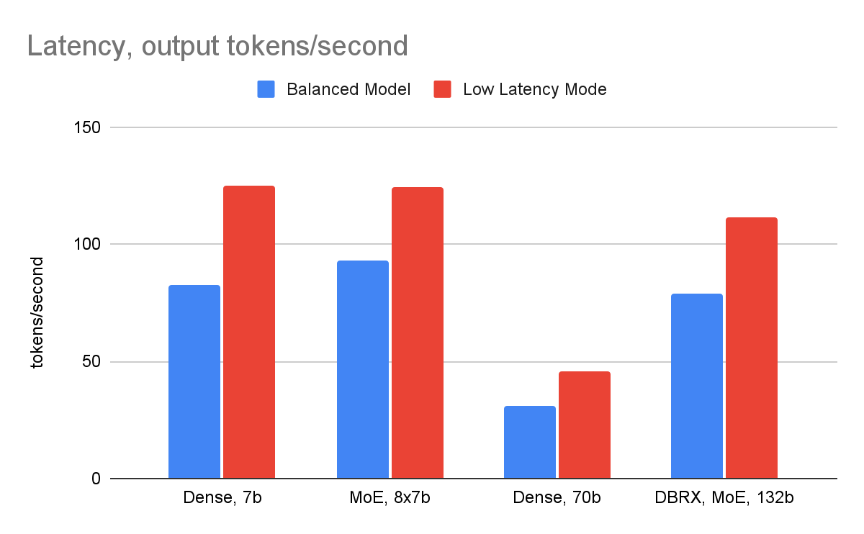
Inference Performance Benchmarks
Setup:
Base/ Any Fine-tuned variant model
Input: 2048 tokens
Output: 256 tokens
Batch size <=4
Bfloat16 (no quantization)
FP8 Quant would improve latency by 1.5x

Slide 23
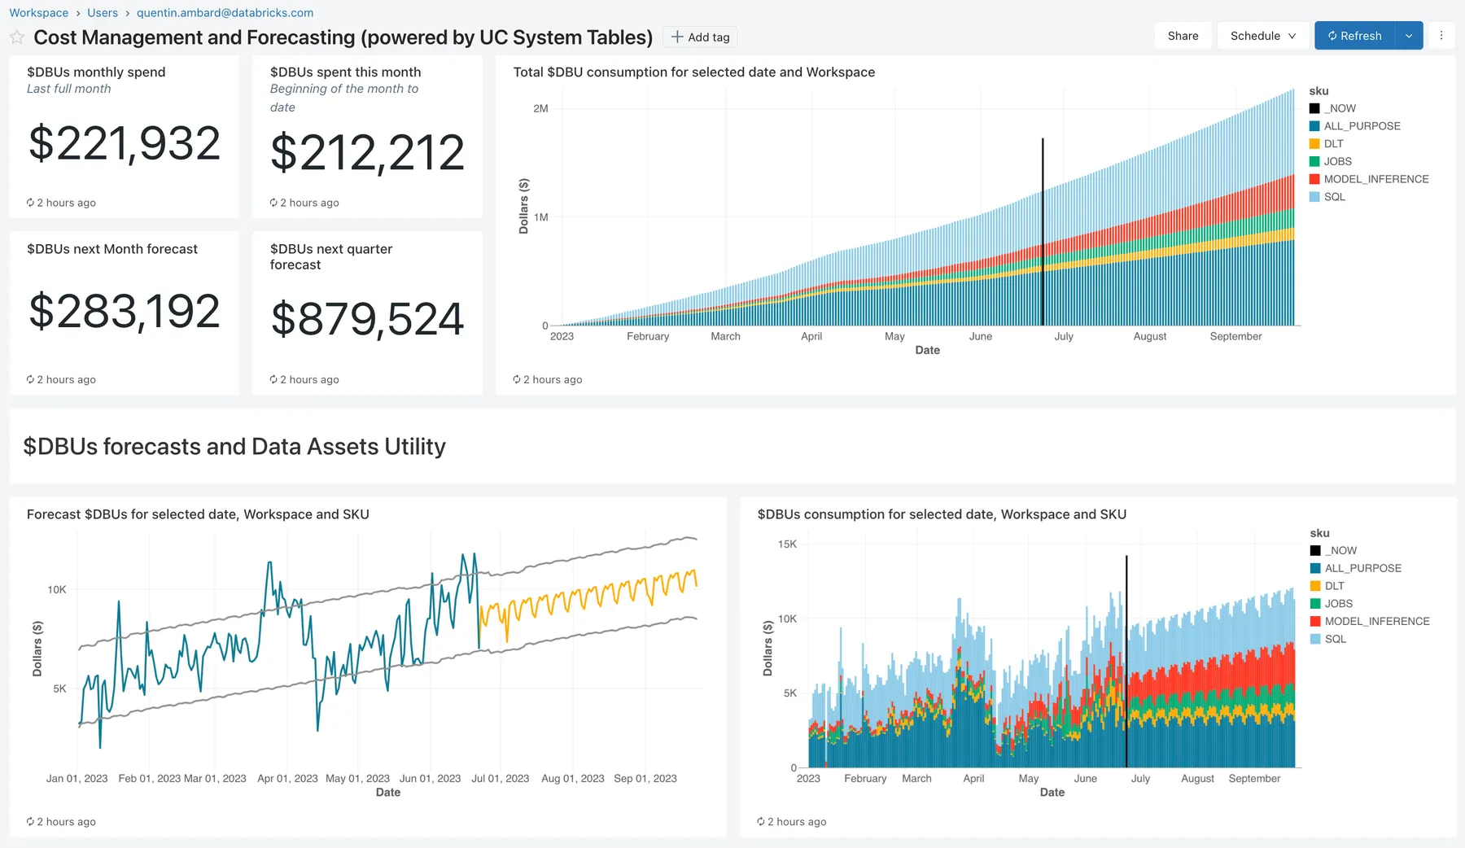
Cost Observability
Monitor usage with system tables and endpoints tags
Leverage Lakehouse existing tools and AI capabilities to continuously monitor and optimize your costs.
System Tables: Monitor consumption and forecast future usage, Trigger alerts when billing goes above your criterias
Endpoint tags: Monitor cost and accurately attribute usage to your organization’s business units and teams

Slide 24
Cost Estimation
Use cost calculator and Load testing to estimate monthly cost
Example
Use the cost calculator to quickly estimate your monthly expenses.
Conduct a load test with DB provided notebook to validate cost estimates.
Collaborate with Databricks Field Engineering team to learn best practices and to optimize costs efficiently.
Cost Calculator
Average QPS: 200
Peak QPS: 500
Model Execution Latency (sec): 0.1
Uptime (min/day): 1440
Scale-to-zero: No
Latency sensitive: Yes
Recommended Workload Size: L
Expected Cost (per month): $1008.00
Min Cost (per month): $806.40
Max Cost (per month): $3225.60
“Expected cost” is what a customer would pay with a constant QPS throughput–where they land in the min/max range depends on autoscaling.

Slide 25
Model Serving Security
Private endpoints Private inbound networking enabled through PrivateLink and IP Allowlist configuration on the workspace
Feature Store configuration Authentication credentials managed by Databricks and same-region networking over cloud provider backbone
Outbound internet access Allowed from the model and can be turned off via support ticket. Blob storage same-region networking over cloud provider backbone
Communication to private resources in your account
If you have any questions or concerns with the Serverless architecture, we strongly recommend scheduling a meeting with the product/eng team and your security team. We are happy to chat!

Slide 26


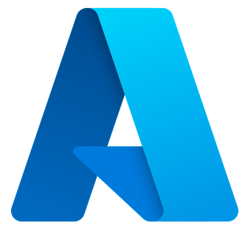

Security: Overall Architecture
Management Flow
1
Manage endpoint configs, rate limits, API keys for remote models, ACLs, and compute for custom or provisioned models
Query Routes
Management Routes
1
Request Flow
2
Workspace access control enforces authentication, authorization, IP access lists, and PrivateLink
Control Plane
Access Control
(AuthN, AuthZ, IP ACLs, PL)
2
3
Model Serving API routes requests to target endpoint, fetches key and URL for remote API endpoints
4
Query routes for custom models or provisioned Foundation Models forwarded to Serverless compute
3
Model Serving API
metadata &
API keys
5
Query routes backed by Foundation Model endpoint is forwarded to Databricks-managed models
6
Query routes backed by remote models is forwarded to respective external model provider
‹#›
Serverless
Compute
4
5
6
Llama 2 Endpoint
MPT Endpoint
BGE Endpoint
Custom Endpoint 1
Custom Endpoint 2
Provisioned Throughput Foundation Model Endpoint
Model
Model
Model
Model
Llama 2
MPT
Pay-per-tokens Foundation Models
External Models
‹#›

Slide 27
Security: Deep Dive
* only applies to Custom and Provisioned Throughput Models
Customer’s Databricks Account
Control Plane
Serverless Data Plane
Control Plane Services
System Services
Isolated Network for Customer 1
Serverless Compute Manager
VM (Model 1)
VM (Model 2)
VM (Model 3)
1
2
Authentication
User request
3
Isolated Network for Customer 2
Load Balancer
4
VM (Model 4)
VM (Model 5)
VM (Model 6)
Scalable DB
VM (Model 7)
VM (Model 8)
VM (Model 9)
Any network communication between two services (1,2,3 and 4) is encrypted.
A VM is never reused and is destroyed after use.
Notes:
At all points during the request your data is always encrypted. You can improve client -> databricks communication using IP access-list or Private Link (AWS)
VMs are never reused. Once a VM is allocated to a customer, after the customer is done utilizing it, the VM gets destroyed and never re-used.

Slide 28

Security: Deep Dive
Customer’s Databricks Account
Customer AWS Account
Customer 1 DBFS
Accessed via presigned URL
2
Model Artifact 1
Model Artifact 2
Model Artifact 3
Control Plane
1
Databricks API Gateway
(Auth, IP Allowlist)
Private Link
Model 1 Table
Model 3 Table
Databricks WebApp
Model Serving Proxy
Model Serving Services
Cluster Manager
Customer 2 DBFS
Serverless Data Plane
Model Artifact 5
Model Artifact 6
Model Artifact 7
System Services
Isolated by ACLs
Serverless Compute Manager
Load Balancer
Model Container Build
4
Model 6 Table
Accessed via presigned URL
Container Registry
Isolated Network for
Customer 1
Isolated Network for
Customer 2
Public Repositories
3
PyPi Repository
VM (Model 1)
VM (Model 2)
VM (Model 3)
VM (Model 5)
VM (Model 5)
VM (Model 6)
Legend
Endpoint creation flow
Conda-Forge Repository
Inference table dataflow
Scoring request path
Notes:
When we are building a model image, we create pre-signed URLs (which expire within 1 hour) to fetch models and artifacts from the model registry in the customer's account. So we never store these artifacts in our account, we only use them to build a model image.What is stored in our account is the model image which is encrypted. When scaling up or down, the model image needs to be pulled into VMs which are also encrypted by TLS. So the model images are encrypted both at REST and in transit.
Our base container image is scanned by a dedicated prod sec team to ensure it is secure. This team also continuously monitors CVEs, threat models, etc. The moment they identify anything, we patch our base OS. This means
The base OS is always up to date with the most secure image that exists
If a new CVE comes up we immediately patch the base image and all future containers are built with the updated image. We are currently working on a mechanism to patch existing images.
GDPR: Once an endpoint is terminated, all VMs serving that endpoint are terminated. Within 30 days, all model images as well as all database entries related to this endpoint are deleted from our account.
For more information check out Serverless Real-Time Inference Security

Slide 29
Overview

Slide 30
Challenges with building Real-time AI Systems
Most AI models don’t get into production
AI infrastructure is hard
Deploying real time models needs disparate tools
Operating production AI requires expert resources
Real-time AI systems require fast and scalable serving infrastructure, which is costly to build and maintain
Customers use separate platforms for Data, Training and Serving, adding complexity and cost
Model deployment is bottlenecked by limited engineering resources, limiting the ability to scale AI

Slide 31
Databricks Model Serving
Serve AI assets with low TCO without worrying about infrastructure
Serverless
Lakehouse-Unified
Simplified Deployment
Highly available and scalable serving with LLM-specific optimization that reduces latency and cost
Automatic feature/vector lookups, monitoring and unified governance that automates deployment and reduce errors
Deploy any model type on CPU or GPU. Automated container build and infrastructure management reduce maintenance costs and speed up deployment.

Slide 32
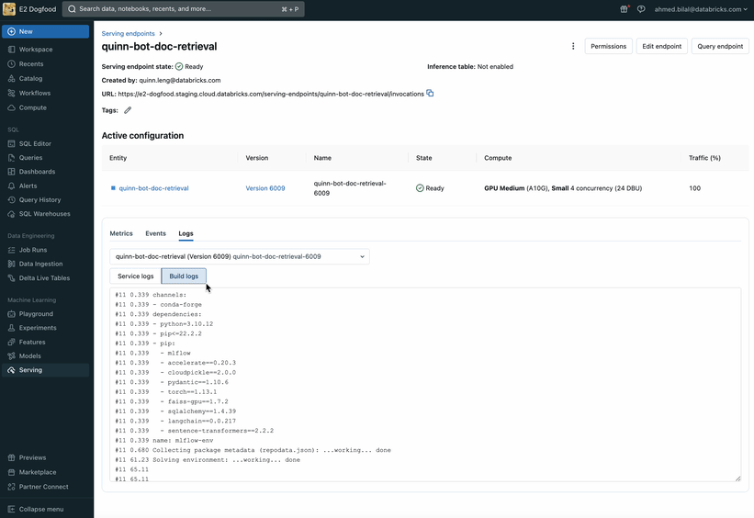
Q1 Developer Experience Improvements
Improved debugging and logging experience: Pre-deployment testing, persistent logs, and clearer error messages.
UI Enhancements: Search, filtering, and tagging capabilities.
Chain Serving: Serve inference graphs or Langchains with streaming and step traceability.
Notes:
go/serving/low-latency

Slide 33
Concurrency = model execution time(s) * peak QPS

